Slide 1
PARTNER AGENT PROGRAM · BY INVITATION ONLY
Stop chasing leads.
Start owning a market.
2.2 million federal employees. 2.6 million retirees. Half a trillion dollars in TSP assets. And almost no one is speaking their language.
We built the website, the pipeline, the CRM, the training, and the software. You bring the license and the work ethic. In 14 days, you're live — on your own federal benefits website, with 50 fresh federal leads dropping straight into your CRM, ready to work.
FED ADVISOR SOLUTIONS · PARTNER AGENT PROGRAM · FedAdvisorSolutions.com

Slide 2
01 · THE OPPORTUNITY
The biggest client base
nobody is fighting for.
Federal employees, postal workers, and retirees are the most under-served, highest-value client base in America — and most agents will never touch them.
2.2M+
600K+
2.6M+
$500K+
Federal civilian employees eligible for FERS, FEGLI, FEHB, and TSP planning.
USPS employees — a huge underserved subset with unique retirement questions.
Federal retirees and survivors making benefits decisions every single year.
Average TSP balance at retirement — every conversation carries real weight.
Sources: OPM FedScope civilian employment data; USPS employee count; OPM retiree rolls; TSP participant balance reports.
FED ADVISOR SOLUTIONS
02 / 14

Slide 3
02 · THE PROBLEM
You've felt this.
Every good agent has.
No brand.
Federal employees don't take meetings with strangers. Without a credible platform, you're just another business card in the recycle bin.
No training.
FERS, FEGLI, TSP, FEHB, survivor benefits — miss one detail and the prospect knows. And they don't come back.
No leads.
Cold-calling feds doesn't work. Buying garbage internet leads doesn't work. You need people who already raised their hand.
No system.
Scripts, CRM, disclosures, follow-up, compliance. Do it alone and you burn out before you break even.
FED ADVISOR SOLUTIONS
03 / 14

Slide 4

03 · THE SOLUTION
We built the machine.
You just plug in.
Same website our advisors use. Same lead engine. Same CRM. Same software. Same training. Your name on the site. Your leads in your CRM — in 14 days.
01
02
03
BRAND
PIPELINE
TOOLKIT
Your own personally-branded federal benefits website — live in days.
50 fresh federal leads to launch — dropped straight into the CRM we provide.
Federal Benefit Specialist training and the Analysis Software Platform — included.
FED ADVISOR SOLUTIONS · PARTNER AGENT PROGRAM
04 / 14

Slide 5
04 · WHAT YOU GET
Everything you need.
Delivered day one.
Five components. One package. Everything you need to look — and perform — like a national federal benefits authority from the day you sign.
01
02
03
Agent-Branded Website
50 Fresh Leads to Launch
CRM + Dialer Included
Your own federal benefits website — your name, photo, and bio positioning you as the federal benefits advisor.
50 warm, opt-in federal prospects requesting a benefits review — delivered with your launch. Additional leads at pass-through cost.
Robust CRM — leads auto-loaded, contact history tracked, email + text templates, predictive dialer built in.
04
05
Specialist Training
Analysis Software Platform
Federal Benefit Specialist training classes on FERS, TSP, FEGLI, FEHB — on demand, if you need them.
The Federal Benefit Analysis Software Platform — the same tool our in-house advisors use to close.
FED ADVISOR SOLUTIONS
05 / 14

Slide 6
05 · YOUR BRANDED WEBSITE
A federal benefits site —
with your name on it.
janedoe.fedadvisorsolutions.com
You get the same website structure our in-house advisors use — the sticky header, the agency pill bar (USPS, VA, FAA, DoD, Armed Forces), the FERS / FEGLI / FEHB / TSP explainers, and the flagship Personalized Benefits Analysis Report request form.
Your Federal Benefits Advisor
Jane Doe · Federal Benefits Consultant
Request My Analysis
Your headshot, name, and bio on the homepage hero.
Your calendar link on every call-to-action button.
Your phone and email on every page and confirmation.
Custom domain, hosting, and SSL — fully managed for you.
Mandatory non-affiliation disclosure — pre-installed and compliant.
USPS
VA
FAA
DoD
ARMED FORCES
FERS Pension Projection
TSP Analysis
FEGLI Life Insurance Review
FEHB Into Retirement
Survivor Benefits Planning
FED ADVISOR SOLUTIONS
06 / 14

Slide 7
06 · CRM INCLUDED
A CRM built to close.
Not a spreadsheet.
A robust CRM platform that houses every incoming lead, tracks every touch, and gives you the tools to work them at scale — emails, texts, and a predictive dialer, all in one place.
Every Lead. Every Touch.
Email + Text Templates
All 100 monthly leads auto-loaded and tagged. Full contact history — calls, emails, texts, notes — attached to every prospect.
Pre-built federal-benefits outreach sequences. First-touch, no-answer follow-up, appointment reminders, post-analysis nurture — send one at a time or drop into automation.
Predictive Dialer Built In
Configured. Not DIY.
Work through your list without hand-dialing. Auto-skip no-answers, log dispositions, drop pre-recorded voicemails — 3x the connects per hour.
Pipelines, disposition tags, cadences, templates — delivered pre-loaded for federal benefits sales. You log in and work leads. That's it.
One platform. One login. Zero setup on you.
FED ADVISOR SOLUTIONS
07 / 14

Slide 8
07 · 50 FRESH FEDERAL LEADS
A pipeline
that never runs dry.
50 fresh, opt-in federal leads land in your CRM to launch — prospects who raised their hand requesting a benefits review. Federal, postal, and military audiences. Reorder on demand at pass-through cost ($50/lead, 50-lead minimum), zero markup.
01
02
03
04
Included with Launch
Never Shared
Lightly Qualified
Reorder On Demand
50 fresh federal leads delivered with your launch package — nothing more to buy on day one.
Your leads, your list, your relationships. Never resold, never recycled to another agent.
Federal, postal, and military employees only — filtered before they hit your CRM.
Order additional leads any time at $50/lead — pass-through cost, zero markup, 50-lead minimum.
FED ADVISOR SOLUTIONS
08 / 14

Slide 9
08 · FEDERAL BENEFIT SPECIALIST TRAINING
Trained. Confident.
Ready to close.
On-demand Federal Benefits video training library plus 1 full day of live 1-on-1 training with our team — so you know FERS, TSP, FEGLI, and FEHB cold before your first lead drops.
Federal Retirement Fundamentals
TSP Deep Dive
FEGLI + Life Insurance Gap
FERS, CSRS, and hybrid systems. Pension math, high-3 calculation, and MRA rules.
Fund selection, glidepaths, catch-up contributions, and rollover strategy at retirement.
Basic and Option A/B/C, retiree premium reduction, and private-market alternatives.
FEHB Into Retirement
Survivor Benefits + Estate Basics
The Analysis-Call Playbook
5-year rule, Medicare coordination, and the FEHB survivor advantage.
SBP elections, survivor annuities, and gap planning for spouses.
How to deliver the Personalized Benefits Analysis and convert to a paid client.
FED ADVISOR SOLUTIONS
09 / 14

Slide 10
09 · ANALYSIS SOFTWARE PLATFORM
The tool that turns
prospects into clients.
The Federal Benefit Analysis Software Platform generates a full personalized federal-benefits picture in minutes — delivered to the prospect and walked through personally. Same platform our in-house advisors use to close.
TSP Analysis
FEGLI Review
FERS Pension Projection
Balance projections and retirement-income modeling by fund allocation.
Retiree premium curves and gap analysis vs. private alternatives.
High-3 math, service years, and MRA-to-62 income shape.
FEHB Into Retirement
Survivor Benefits Gap
Annual Refresh
5-year eligibility, plan continuation, and Medicare coordination.
SBP elections and life-insurance coverage recommendation.
Free annual update — turns every client into a renewable relationship.
FED ADVISOR SOLUTIONS
10 / 14

Slide 11
10 · YOUR INVESTMENT
A serious business.
A modest cost of entry.
01
Agent-Branded Website
02
50 Fresh Leads to Launch
03
CRM + Dialer
04
Specialist Training
05
Analysis Software
All five, included in every partner package below.
ONE-TIME LAUNCH FEE
MONTHLY
VARIABLE · AS YOU SCALE
$4,995
$300
$50
launch
/ month
/ lead
Launch Package
Hosting + Platform
Additional Leads
Agent-branded website build + deployment
CRM with email + text templates
50 fresh federal employee leads
Federal Benefits Analysis Platform access
Federal Benefits video training library
1 full day of live 1-on-1 training
Website hosting, SSL + uptime
CRM, dialer, email + SMS templates
Analysis Platform access + updates
Video training library — always on
Compliance monitoring + support
Ongoing site updates + fixes
Fresh federal employee leads on demand
Pass-through cost — zero markup
50-lead minimum order
Never shared with other agents
Auto-fed into your CRM
Federal / postal / military only
Compare to $30K–$75K to build a practice like this from scratch.
FED ADVISOR SOLUTIONS
11 / 14

Slide 12
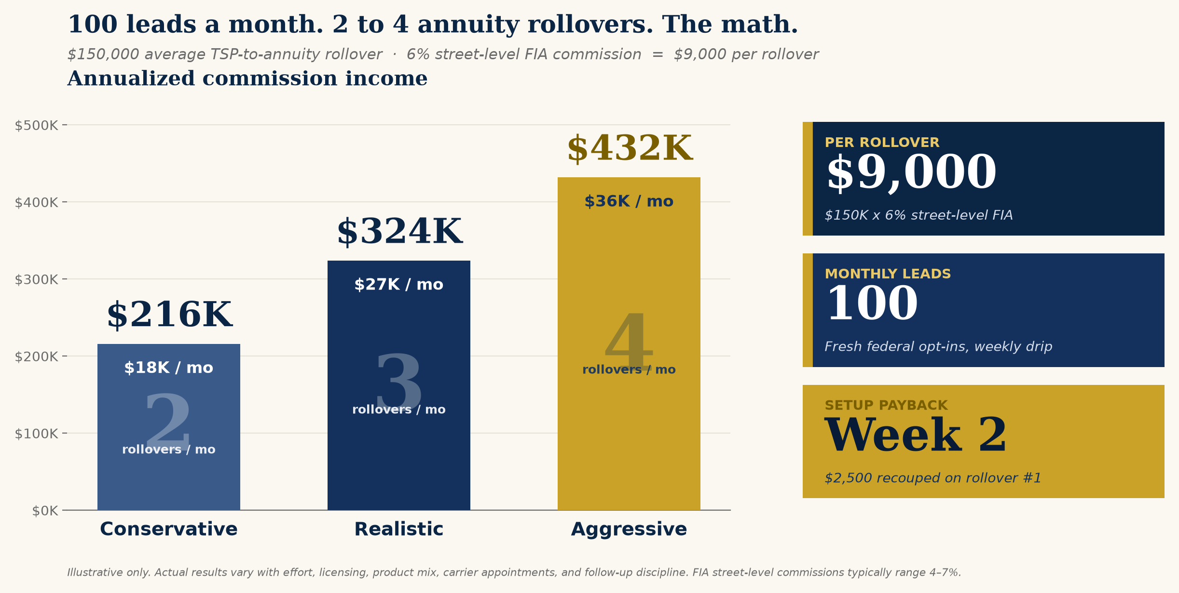
11 · THE ECONOMICS
The math works. Aggressively.
Even the conservative column pays back your $4,995 launch investment inside Month 1 — and funds a full year of hosting.
FED ADVISOR SOLUTIONS
12 / 14

Slide 13
12 · IS THIS YOU?
Who this is
built for.
A GREAT FIT
NOT A FIT
You should absolutely be on this call.
We'd rather tell you now.
Licensed life & health agent (or willing to become one).
Serious about building a repeatable, referable practice.
Comfortable on video, phone, and Zoom appointments.
Willing to follow a proven system — not reinvent it.
Wants to enter the federal space without starting from zero.
Looking for a passive-income get-rich-quick plan.
Unwilling to work leads within 48 hours of delivery.
Won't follow the compliance and disclosure requirements.
Chasing the shiny object every 30 days.
Not licensed and not planning to get licensed.
FED ADVISOR SOLUTIONS
13 / 14

Slide 14
13 · NEXT STEPS
You didn't get on this call by accident.
Let's build your federal benefits practice.
01
02
03
Book Your Onboarding Call
Complete Your Training
Go Live in 14 Days
30-minute working session to lock in domain, photo, bio, and CRM setup.
1 full day of live 1-on-1 training with our team before your first lead drops.
Website launched, CRM live, analysis platform ready, first 50 leads delivered.
Ready to build? Apply at FedAdvisorSolutions.com · Call Mario Roker · Fed Advisor Solutions
14 / 14

